Slide 1

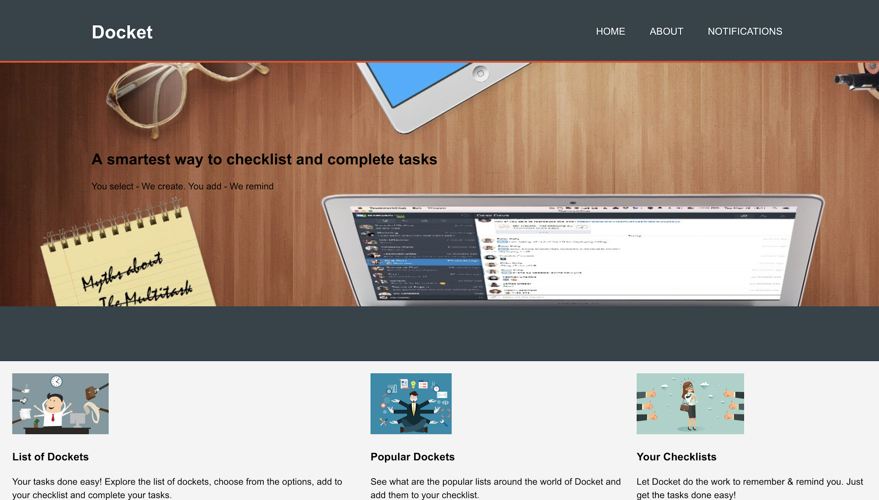
DOCKET
Amulya Minumula
IWS Project Presentation
12/11/18

Slide 2
Outline
Objective
Why Checklists?
Types of Checklists
About Docket
How I Started?
Tools and languages
What i’ve learned
What’s next?

Slide 3
Objective
Objective is to create one huge platform for the users where they can view a number of checklists listed.
User should be able to add checklists and create To-Do Lists which can be viewed on Your Checklists/To-Do Lists

Slide 4
Why Checklists?
Reasons to create a checklist
It will allow you to be more creative: Not having to remember the important steps, because it’s all written down, will make way for more creative brain power to be utilized.
Delegating and handing over tasks will be easier: A foolproof step-by-step guide will make handing over tasks easier as you won’t have to worry about something not being done right.
It will improve productivity: Having a checklist on hand will ensure you complete your task quickly and efficiently, allowing you to accomplish more things within your time.

Slide 5
Types of checklists
Task Checklist
Discipline Checklist
Troubleshoot checklist
Coordination Checklist

Slide 6
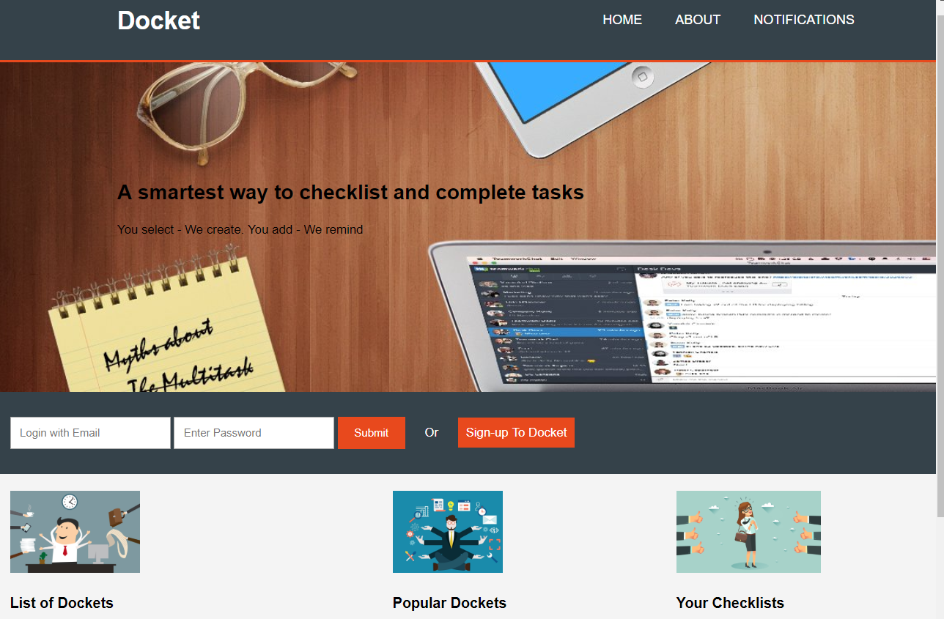
About
Docket

Slide 7
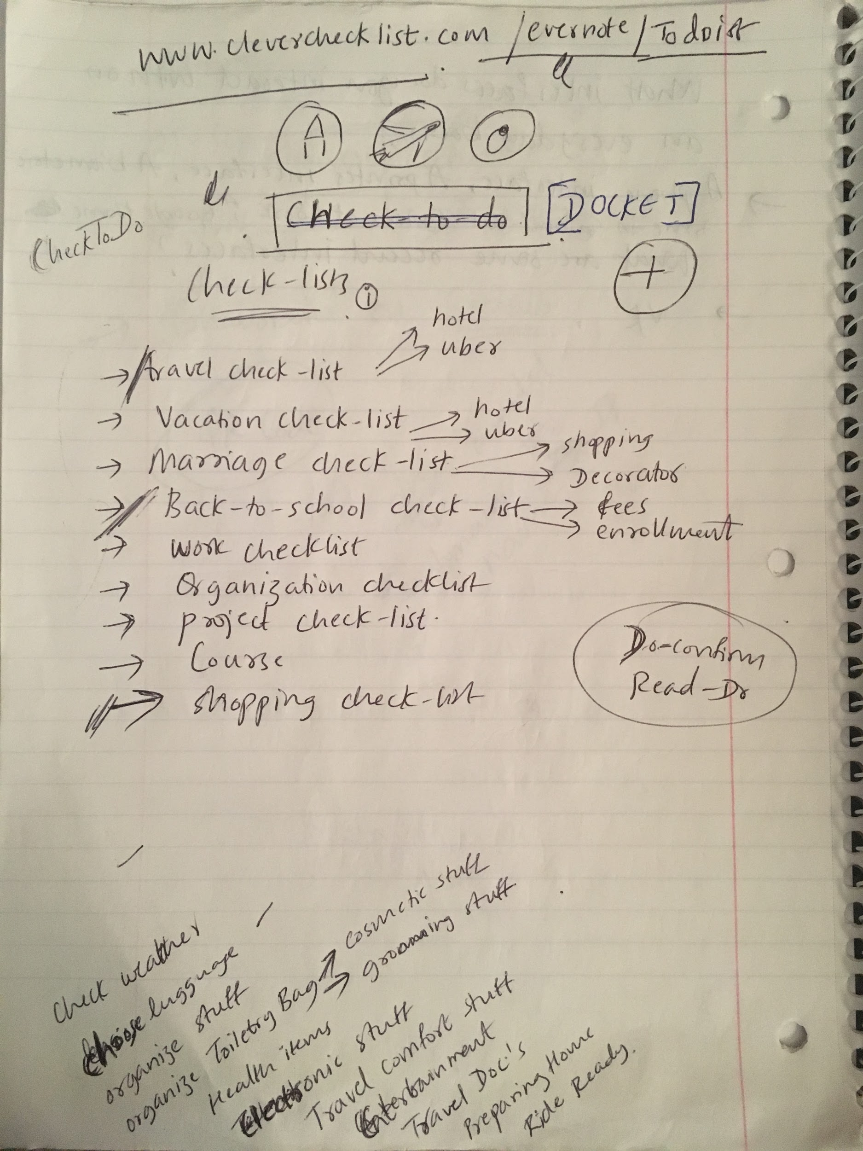
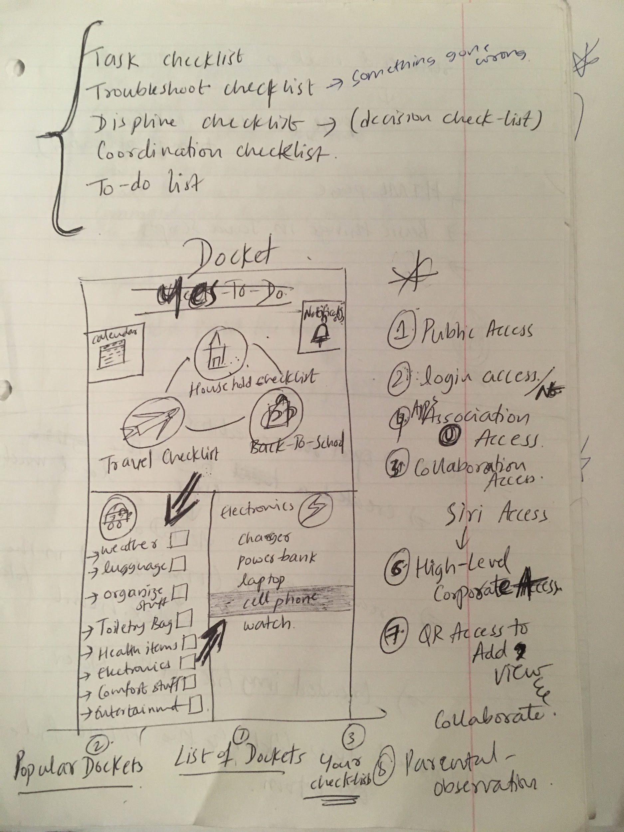

How I started?

Slide 8
Tools And languages
Tools and languages implemented:
HTML
CSS
JavaScript
MySQL
PHP
XAMP
phpMyAdmin

Slide 9
What i’ve learned
!!!

Slide 10
What next?
To create more styling for the user interface
Create machine learning algorithms to view the popular dockets
To create calendar for notifications

Slide 11
Thank you!

